Slide 1











2024
International Symposium on
Carbon Neutral Fuel Technology
10th (Thu) – 11th (Fri). Oct. 2024
BEXCO Convention hall, Busan, South Korea
Hosted by
Ministry of Trade, Industry and Energy
Korea Energy Technology Evaluation and Planning
Korea Advanced Institute of Science and Technology
Organized by
KAIST Combustion Engineering Research Center (CERC)
KSAE Mobility Power and
Drive Systems Subcommittee
Sponsored by
Carbon Neutrality and Green Growth Committee
Korea Automotive Technology Institute
The Korean Society of Combustion
The Institute for Liquid Atomization and Spray Systems - Korea
The Korean Society of Marine Engineering
Welcome to the Symposium
In response to the urgent call for carbon neutrality to overcome the climate crisis, diverse and innovative energy technologies are developed. A single solution is insufficient; therefore, we are committed to developing a wide range of technologies, including renewable energy, electrification, efficiency improvements, bioenergy, carbon capture·utilization and storage (CCUS), behavioral change, hydrogen, and fuel shift. Energy and environmental experts are collaborating to dedicate themselves to the development of these breakthrough technologies.
We cordially invite you to join us and contribute your esteemed insights as we explore global trends and each nation's efforts in the production and utilization of carbon-neutral fuels across the automotive, shipping, aviation, and power generation sectors. Together, we will lead the way towards a sustainable and carbon-neutral future.
Vision of Carbon Neutral Fuel Technology
The symposium seeks to share insights and advancements in carbon-neutral fuel technologies, discuss global trends and national efforts in the production and utilization of these fuels across different sectors such as automotive, shipping, aviation, and power generation. It also fosters collaboration among industry, academia, and policymakers to pave the way for a sustainable and carbon-neutral future.

Slide 2
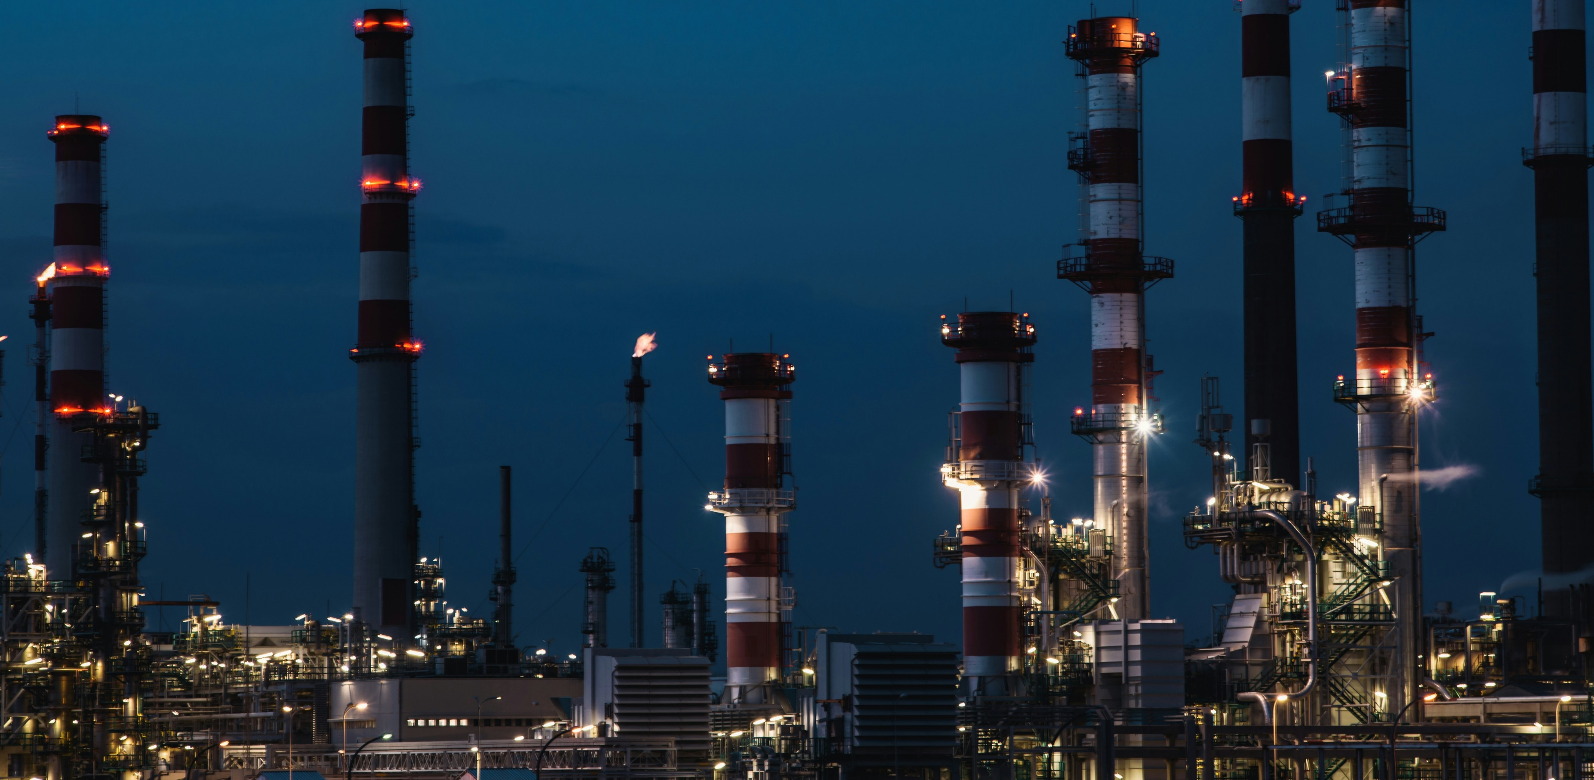
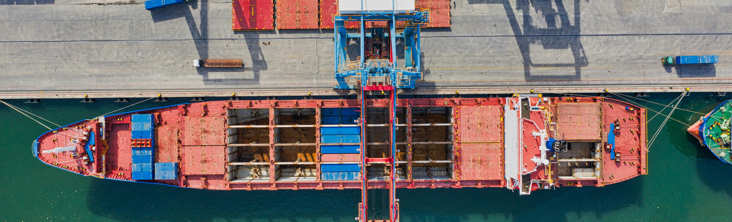
Symposium Program
10th. Oct. 2024
Time | Titles (temporary) | Speaker
09:30-12:00 | Carbon Neutrality Scenario of IEA | Choongsik Bae (KAIST)
 | Hydrogen Supply Chain and Application Technology | Jaewoo Chung (KATECH)
 | e-Fuel Production through the Fischer-Tropsch Process | Donghyun Chun (KIER)
 | Automobile E-fuel Engine Development | Heechang Oh (Hyundai Motors Group)
 | E-Fuel Engine Development for Ships and Land Power | (HD Hyundai Heavy Industry)
 | Mobile Carbon Capture | Minhye Seo (IAE)
 | Combustion of Hydrogen and Ammonia in Gas Turbines | Donghoon Lee (Doosan Enerbility)
12:00-13:30 | Break, Lunch
13:30-14:00 | Low Carbon Fuels for On- and Off-Road transportation in the U.S. | Paul Miles (Sandia National Lab., U.S.)
14:00-14:30 | Japanese Efforts in E-fuel Application | Yasuo Moriyoshi (Chiba University, Japan)
14:30-15:00 | Ammonia and Methanol Combustion Technologies in China | Mingfa Yao (Tianjin University, China)
15:00-15:20 | Break
15:20-15:50 | German E-fuel Development | Thomas Koch (KIT, Germany)
15:50-16:20 | Development of Integrated Production Technology for Synthetic Liquid Fuel (e-fuel) | Takehisa Mochizuki (AIST, Japan)
16:20-16:50 | E-fuel Supply Chain & Application | Tobias Block (E-fuel Alliance, Germany)
16:50-17:00 | Break
17:00-18:00 | Panel Discussion - Strategies for the Development of E-Fuel Industry Donghee Han(Hyundai Motors Group), (HD Hyundai Heavy Industry), (Doosan Enerbility), (HD Infracore), (HD Hyundai Oilbank)
11th. Oct. 2024
Time | Contents
10:00-13:00 | Thematic mini-symposium

